Slide 1
SMA Experiment No. 6
Social Network Analysis

Slide 2
Importance in Business
Businesses as webs: Social network analysis (SNA) helps understand businesses by mapping connections between people, teams, and other parts, like a web.
See who talks to whom: SNA reveals how well connected different parts of the business are, showing communication gaps or strong collaboration.
Find new connections: SNA helps identify people who could work well together on projects, even if they don't normally connect.

Slide 3
Social Network Structure
Social network structure refers to the pattern of connections or relationships among individuals or entities within a social network. Understanding the structure of a social network is crucial for analyzing its dynamics, identifying key players, and predicting how information, resources, or influence flow through the network.
Types of Structure:
Centralized: Few nodes hold most connections.
Decentralized: Nodes share connections evenly, no central authority.
Hybrid: Mix of centralized and decentralized elements.

Slide 4
Centrality
Centrality refers to the importance or influence of a node within a network. It's a measure of how central or pivotal a node is in facilitating communication, information flow, or control within the network. Centrality metrics evaluate different aspects of this importance, such as a node's connections to others, its position in the network's structure, or its ability to mediate interactions between other nodes. Essentially, centrality helps identify key nodes that play significant roles in the functioning or dynamics of a network.

Slide 5
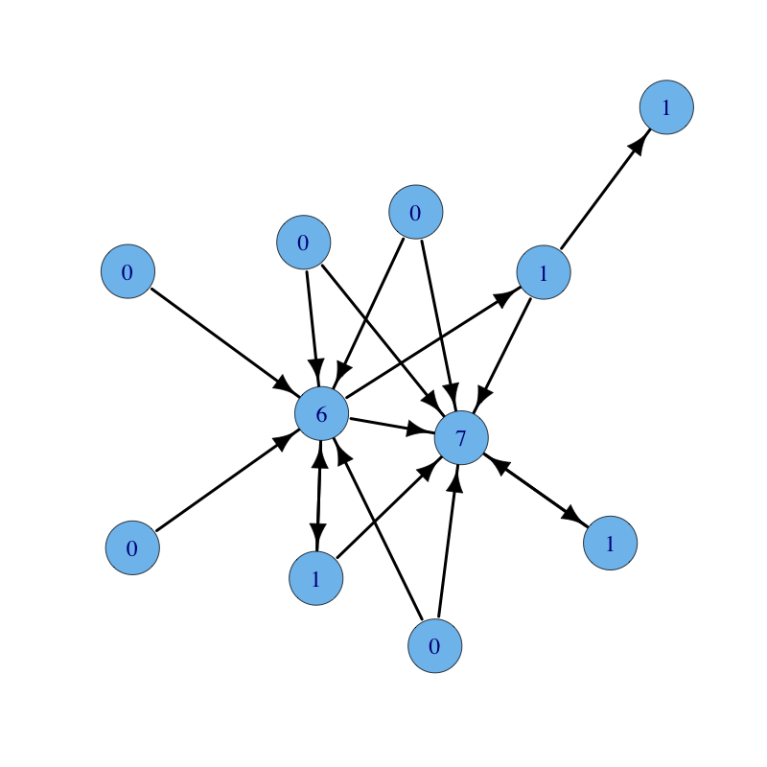
Degree Centrality
This metric simply counts the number of connections a node has. It's like measuring popularity in a social network; the more friends you have, the higher your degree centrality. Nodes with higher degree centrality often have more influence, control, or access to information within the network.

Slide 6
Betweenness Centrality
This measures the extent to which a node lies on the shortest paths between other nodes. Think of it as identifying key intermediaries or bridges in a network. Nodes with high betweenness centrality act as critical connectors, facilitating communication, information flow, or even control between disparate parts of the network.

Slide 7
Closeness Centrality
It calculates how close a node is, in terms of shortest paths, to all other nodes in the network. Essentially, it quantifies how quickly information or influence can spread from a particular node to others. Nodes with high closeness centrality can efficiently interact with others, making them important for spreading information or influence rapidly through the network.

Slide 8
Eigenvector Centrality
Unlike degree centrality, eigenvector centrality takes into account not only the number of connections a node has but also the quality of those connections. It assigns higher centrality to nodes that are connected to other highly central nodes. In essence, it's a measure of influence: a node with high eigenvector centrality is not only well-connected but is also connected to other nodes that themselves are influential, indicating a position of importance or authority within the network.

Slide 9
Tools Used
Netlytic:
Web-based platform for automated text and social network analysis.
Analyzes online conversations like social media data and discussion forums.
Helps uncover patterns, trends, and insights within the analyzed data.
Python:
High-level programming language known for simplicity and readability.
Widely used across various applications including data analysis, machine learning, and automation.
Renowned for its versatility and extensive library support.

Slide 10
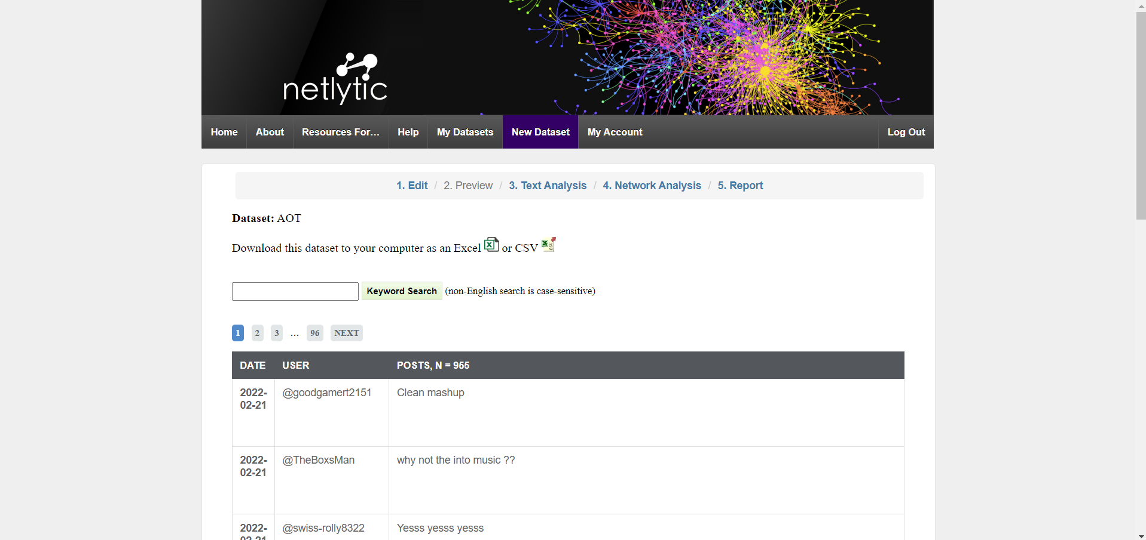
Nelytic

Slide 11
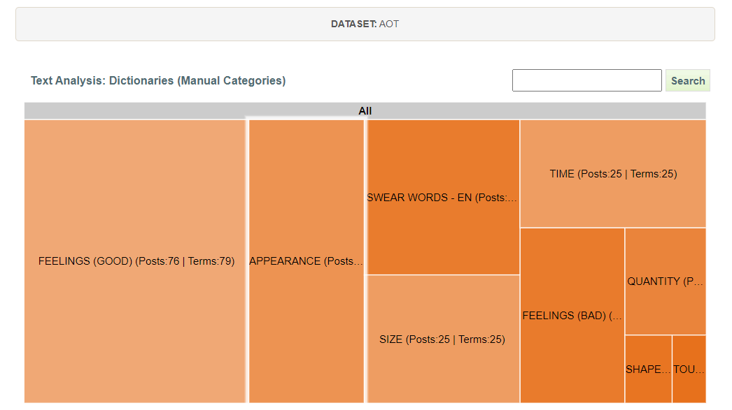
Nelytic :Text Analysis

Slide 12
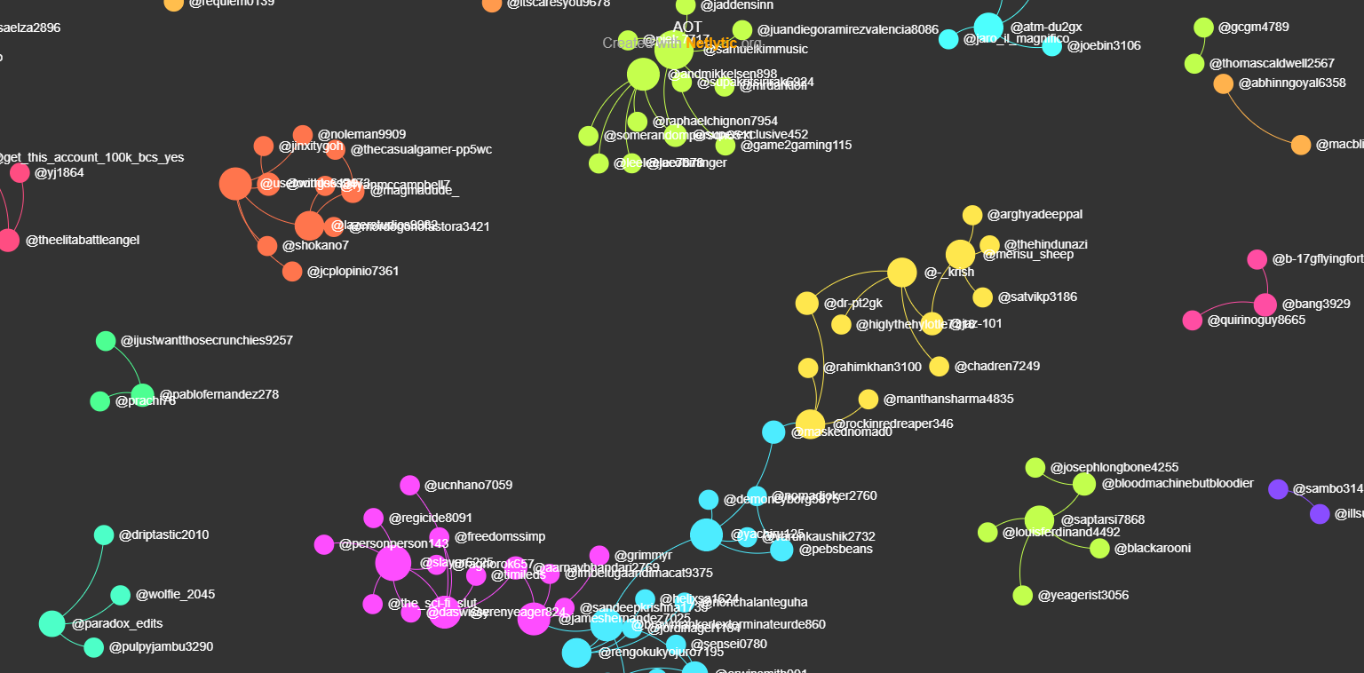
Nelytic : Links

Slide 13
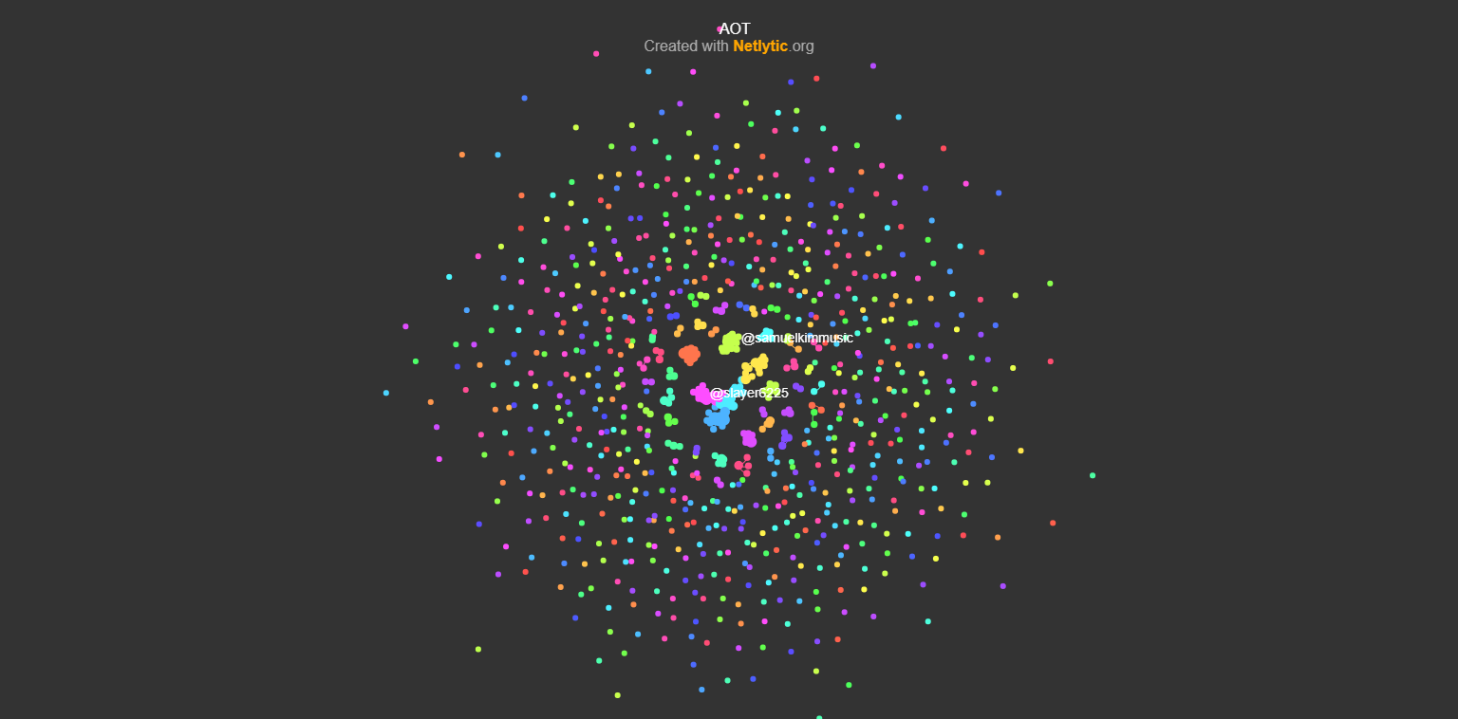
Nelytic : Total Degree

Slide 14
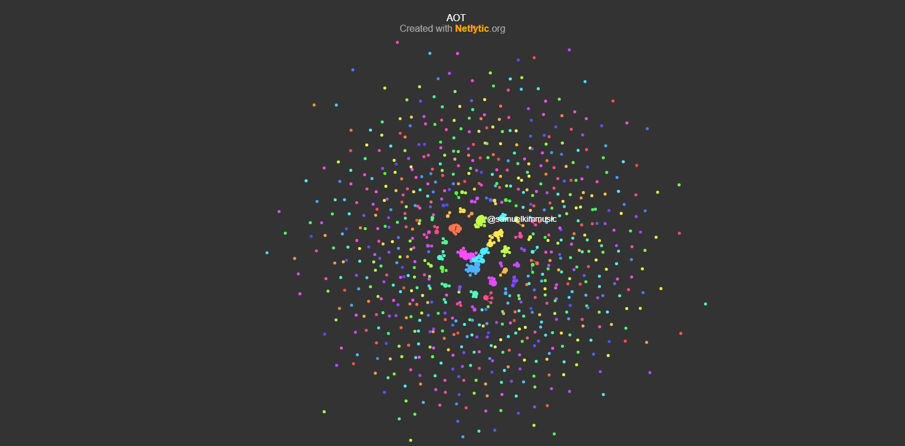
Nelytic : In Degree

Slide 15
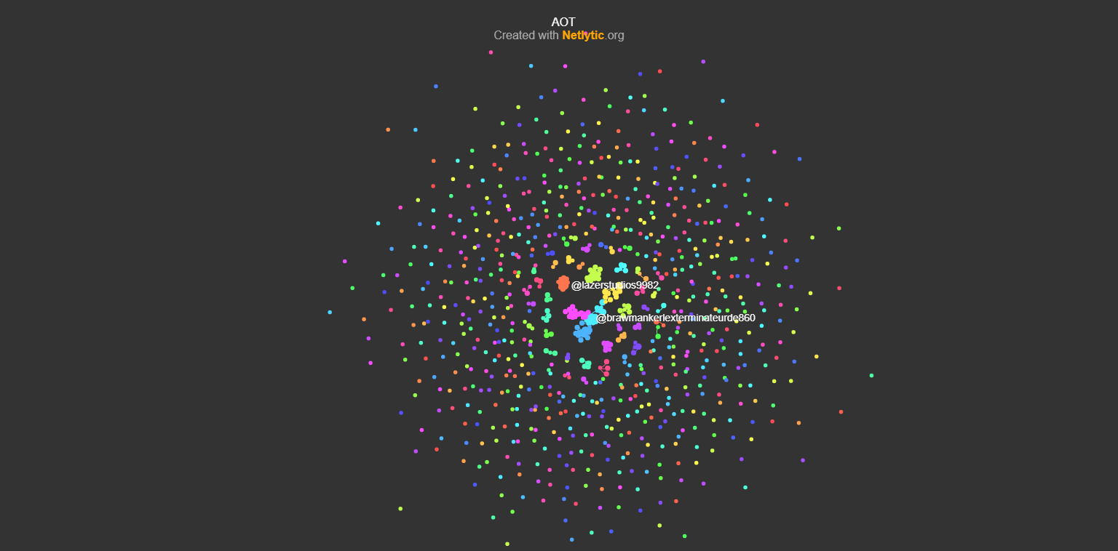
Nelytic : Out Degree

Slide 16
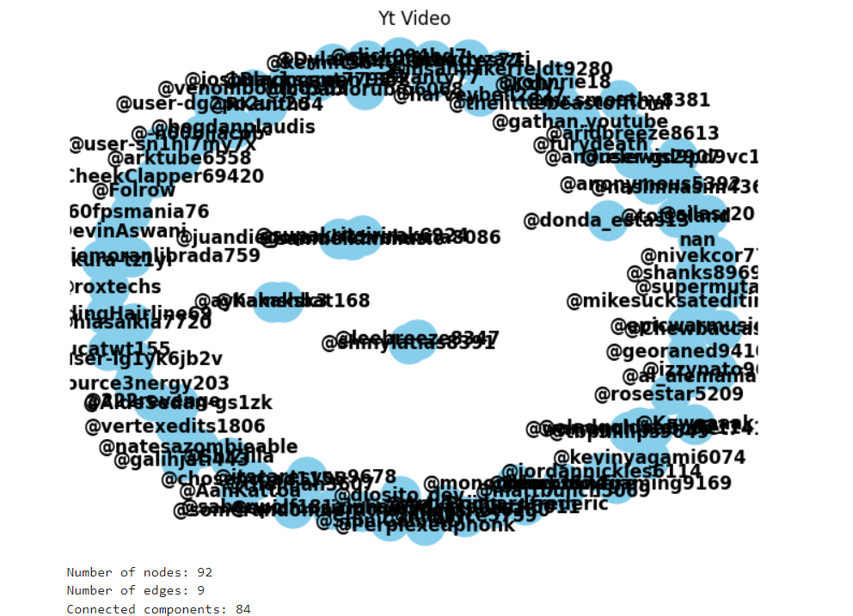
Python

Slide 17
Thank You

